Slide 1

Computer Programming for Engineers
Week 6 Lecture 1
Oct. 4, 2022
Lecturer: Mohammad Mahdi Javidan
College of Engineering, Sungkyunkwan University
Fall Semester 2022

Slide 2
Topics for Midterm Exam
Notice:
The exam is on Thursday, 6 October, in the classroom,15:00-16:15.
Only one file with the extension of ipynb or py shall be submitted.
Don’t use the internet. Answers shall be your own original codes and you cannot use other sources.
Your codes shall produce the test cases, otherwise no credits are given for the test cases that are not generated.
The total point is 100 which accounts for 35% of the final grade.
There are many different questions, try to solve questions based on their simplicity, points, and your time.
College of Engineering, Sungkyunkwan University

Slide 3
Example Problems
Write the function book(dict_1) which receives the dictionary variable dict_1 containing the number of books borrowed from the library as values, against students’ admission years as keys. The function returns the dictionary dict_2 which consists of students’ admission years as keys and the percentage of books they borrowed.
Test case:
College of Engineering, Sungkyunkwan University

Slide 4
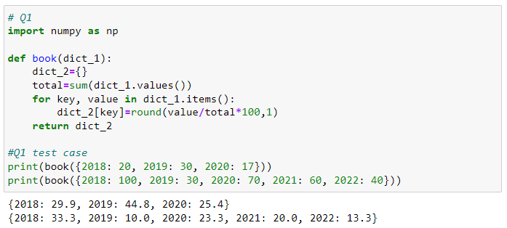
Example Problems
College of Engineering, Sungkyunkwan University

Slide 5
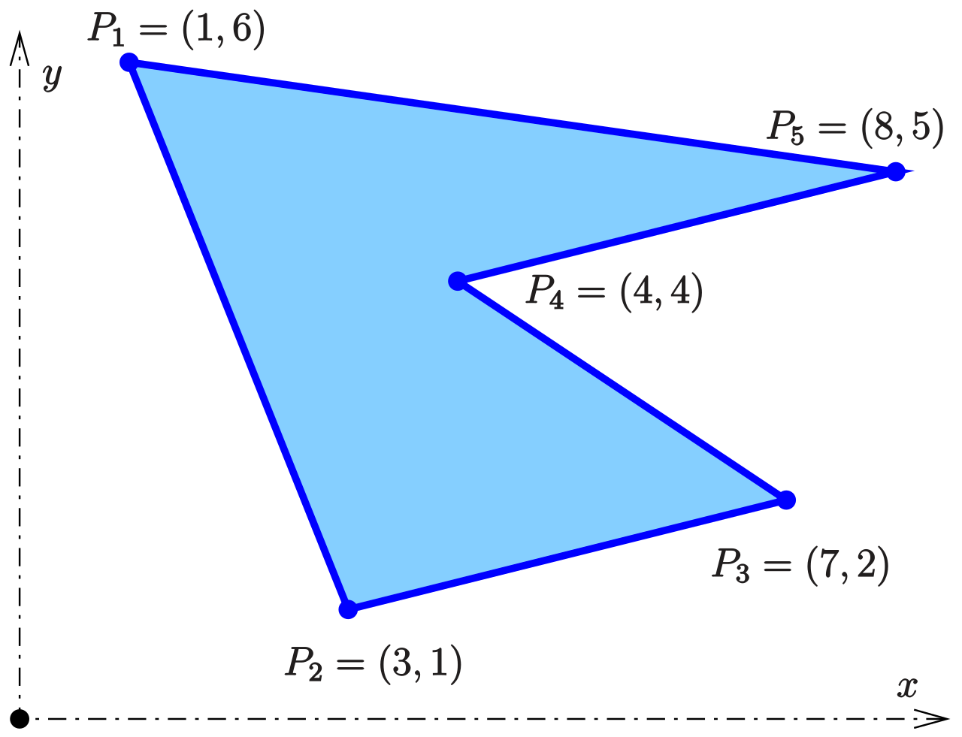







Example Problems
Program a function area(M) which receives the coordinates of several points in each row and calculate the area enclosed between them using the shoelace formula. Assume that the points are ordered in a clockwise manner.
Test case:
$$(x_{3},y_{3})$$
$$\left[\begin{matrix}x_{1} & y_{1} \\ x_{2} & y_{2} \\ x_{3} & y_{3}\end{matrix}\right]$$
$$Area=0.5(x_{1}y_{2}+x_{2}y_{3}+x_{3}y_{1}−x_{2}y_{1}−x_{3}y_{2}−x_{1}y_{3})$$
$$(x_{2},y_{2})$$
$$\begin{matrix}x_{1} & y_{1}\end{matrix}$$
$$(x_{1},y_{1})$$
College of Engineering, Sungkyunkwan University

Slide 6
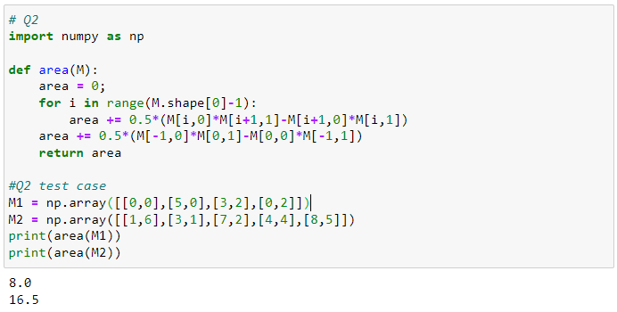
Example Problems
College of Engineering, Sungkyunkwan University

Slide 7
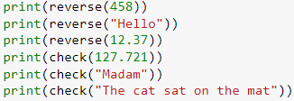

Example Problems
Write a function reverse(str_1) which receives a number or a string and returns its reverse.
Use the aforementioned function and program a function check(str_1) which receives a number or a string and returns True if it is read the same in reverse, otherwise returns False.
Test case:
College of Engineering, Sungkyunkwan University

Slide 8
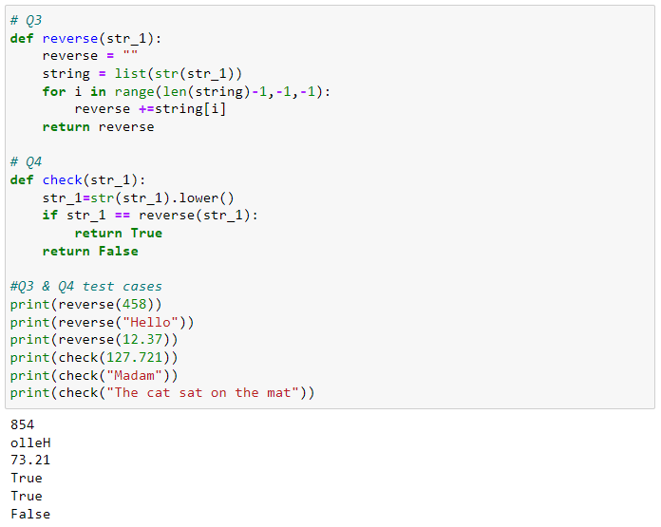
Example Problems
College of Engineering, Sungkyunkwan University

Slide 9


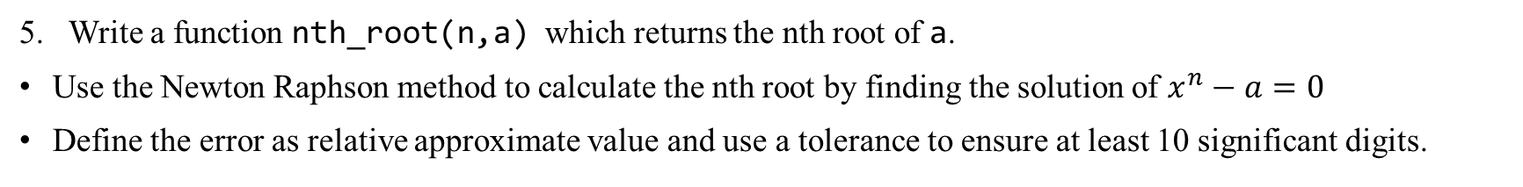
Example Problems
Write a function nth_root(n,a) which returns the nth root of a.
Use the Newton Raphson method to calculate the nth root by finding the solution of $x^{n}−a=0$
Define the error as relative approximate value and use a tolerance to ensure at least 10 significant digits.
Test case:
College of Engineering, Sungkyunkwan University

Slide 10
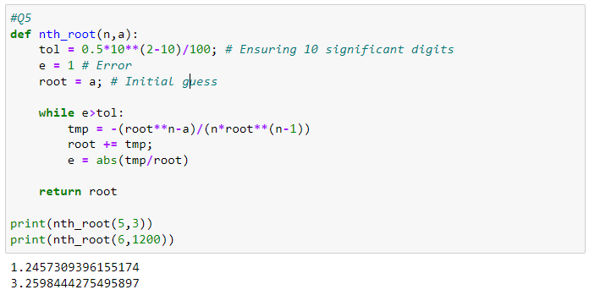
Example Problems
College of Engineering, Sungkyunkwan University

Slide 11


Example Problems
Write a function word_check(str_1,str_2) which returns True if the characters constituting str_1 and str_2 are the same, otherwise returns False. Capital and small letters are not the same characters.
Test case:
College of Engineering, Sungkyunkwan University

Slide 12
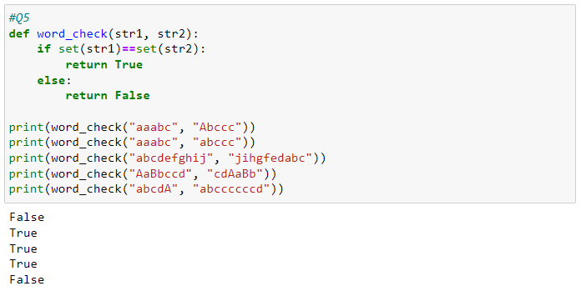
Example Problems
College of Engineering, Sungkyunkwan University

